Slide 1
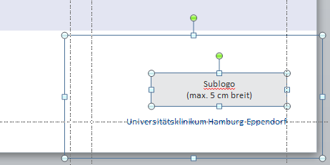
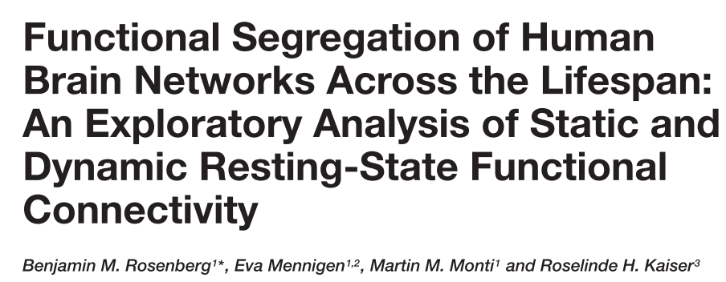
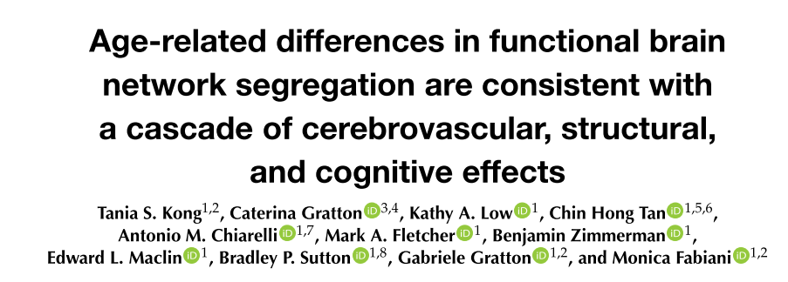
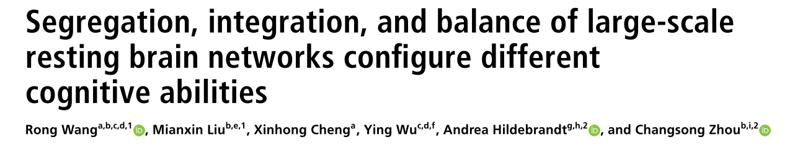
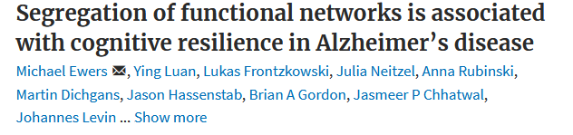
Journal Club
Research
Die Möglichkeit, ein Sublogo zu platzieren, haben Sie auch auf den anderen Titelseiten-Layouts.
Markieren Sie sich hierzu alle Elemente in der unteren rechten Ecke und kopieren Sie sie mit STRG+C.
Gehen Sie auf eines der anderen Titel-Layouts und drücken Sie STRG+V, um die Elemente an gleicher Stelle einzufügen.
Markieren Sie dann das rote Hinweisfeld an der oberen rechten Ecke und löschen es.
(Maximilian Schulz | 08.008.2021)
Universitätsklinikum Hamburg-Eppendorf

Slide 2
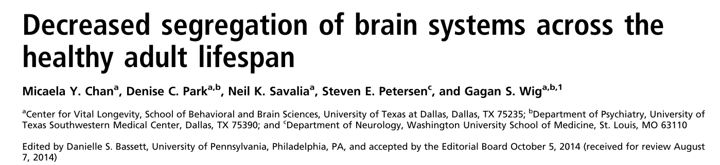
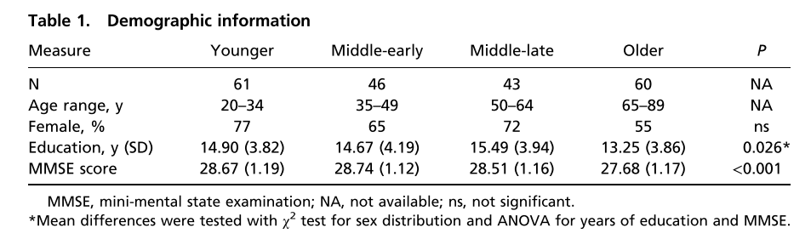
healthy adult lifespan sample (n = 210; 20–89 y)

Slide 3
Introduction
Functional specialization of a system characterized by the balance of connections between areas within the system and limited interaction with areas in other systems.
Modular architecture facilitates the common processing roles of areas within similar systems while allowing communication between systems with distinct connections
Any deviation in the patterns of within- and between-system connectivity may be considered evidence for a change in the system’s specialization.
Cognitive decline evident even in healthy older adults may be related to decreased functional integrity at a systems level of organization

Slide 4
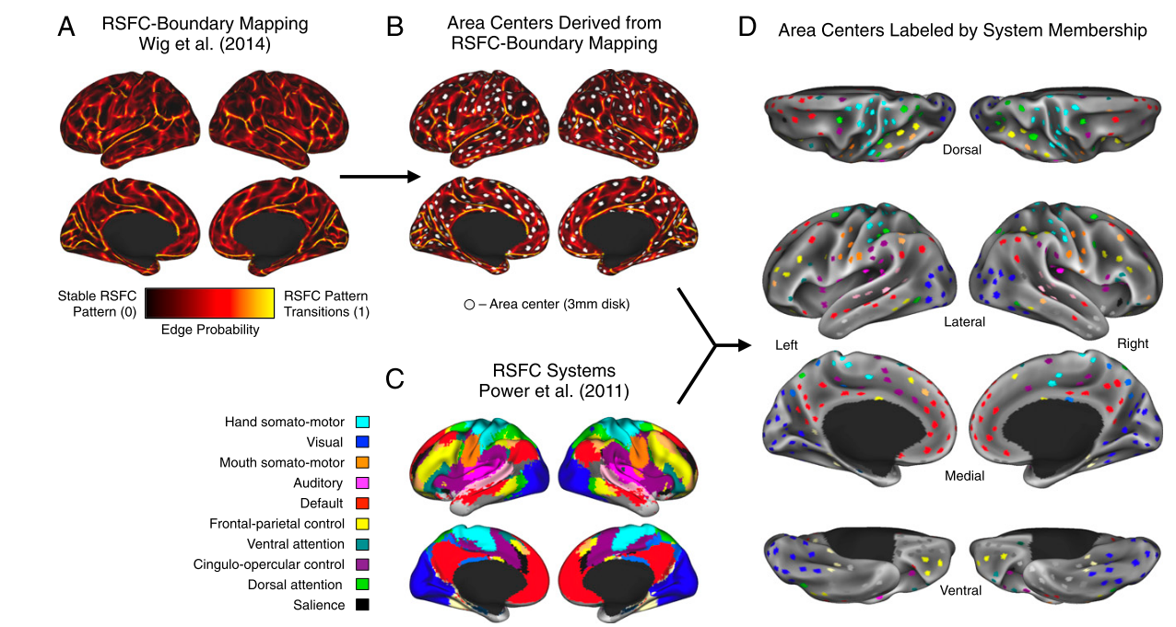
Parcellation
(Journal Club)
Probability of RSFC pattern transitions across the cortical surface.
Local minima of RSFC transition parcellation map (8 mm apart, within the FreeSurfer medial wall excluded, 3-mm geodesic radius around each minima > total of 441 nonoverlapping disks)
Disks were labeled according to their functional network (system) membership by a map of Power et al.

Slide 5
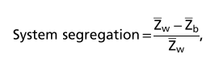
Connectvitiy analysis
441 × 441 z-matrix with the diagonal and negative values set to zero.
Within system connectivity as the mean node-to-node z-value of all nodes of that system to each other (e.g., the mean of the z-values between all default system nodes to all other default system nodes
Between-system connectivity as the mean node-to-node z-value between each node of a system and all nodes of all other systems (e.g., mean of z-values between all default system nodes and all other nodes in the brain)
System Segregation: differences in mean within-system and mean between-system correlation as a proportion of mean within-system correlation
Segregation retains the weight of all positive edges in a graph, allowing weak connections to contribute to the characterization of system interactions.
Values greater than 0 reflect relatively lower between-system correlations in relation to within-system correlations (i.e., stronger segregation of systems), and values less than 0 reflect higher between-system correlations relative to within-system correlations

Slide 6
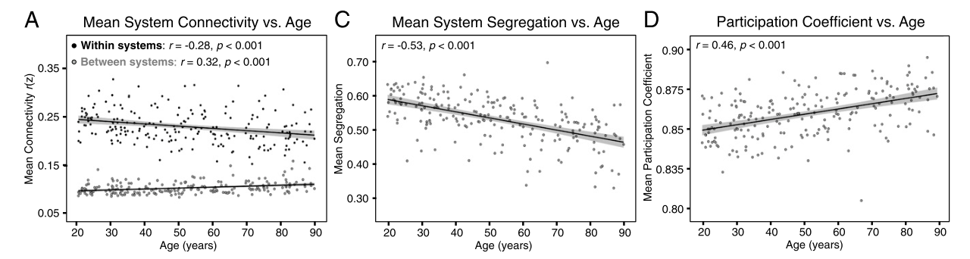
Results
Across age, segregation greater than 0 >> mean within-system correlations are stronger than mean between-system correlations, regardless of age
Older age is associated with decreasing system segregation, in 8 of the 10 systems of interest when interrogated individually,
Relationship between age and system segregation was robust across multiple choices related to matrix thresholding (i.e., inclusion of negative edges, thresholded vs. unthresholded graphs..)

Slide 7
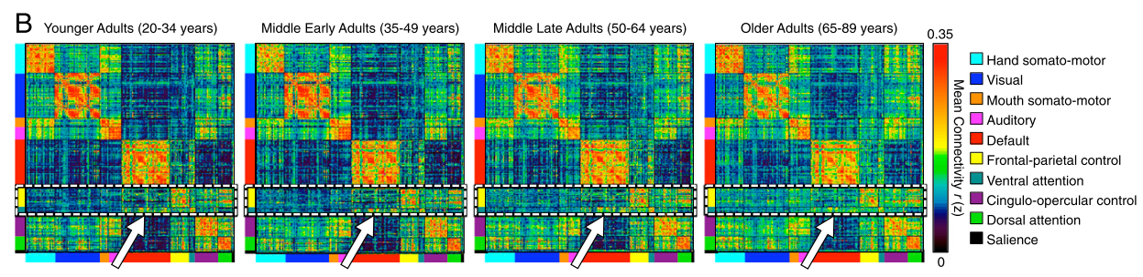
Results
Within-system RSFC (on matrix-diagonal) exhibits decreasing strength across cohorts, whereas between-system RSFC (off matrix-diagonal) exhibits increasing strength across cohorts.
Frontal–parietal control or the Ventral attention system (highlighted with a white box) with other brain systems (e.g., default system; white arrows) are increasingly greater from younger to older adult

Slide 8
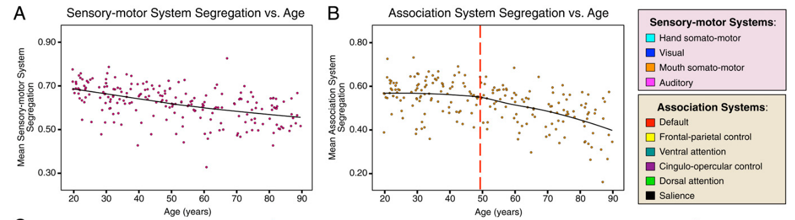
Results
Association and sensory-motor systems exhibit distinct patterns of age-related differences in segregation
Sensory: engaged in neural coding and transformation of incoming sensory and outgoing motor
Association: direct and integrate information in a wide range of tasks and across multiple
Decreasing segregation of both association and sensory-motor systems
Sensory-motor system segregation: age function was fit significantly only by a linear model [t(208) = −8.28, P < 0.001, adjusted R2 = 0.24]
Association system segregation was fit significantly by both a linear and a quadratic model (t = −8.55, P < 0.001) , [t(208) = −2.80, P < 0.001]

Slide 9
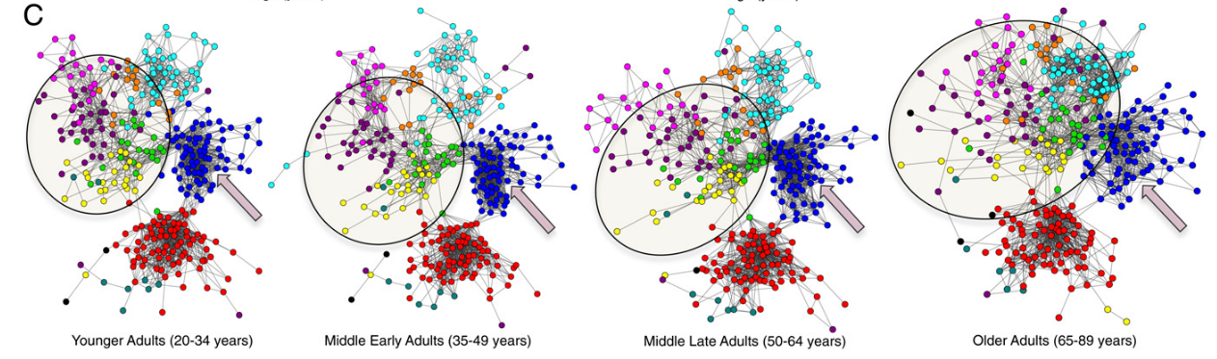
Results- Spring-embedded layouts of the 10 systems of the four cohorts’ mean correlation matrices
Association systems exhibit less within-system connectivity and greater between-system connectivity, particularly in the oldest age cohort
Sensory-motor systems exhibit progressive age-accompanied reductions in both within-system correlations and segregation with other systems (e.g., the visual system, highlighted by the arrows)
Association systems exhibit prominent and sudden decreases in segregation with other systems starting in middle-late adulthood [e.g., the frontal–parietal control (in yellow) and cingulo-opercular control systems (in purple) exhibit

Slide 10
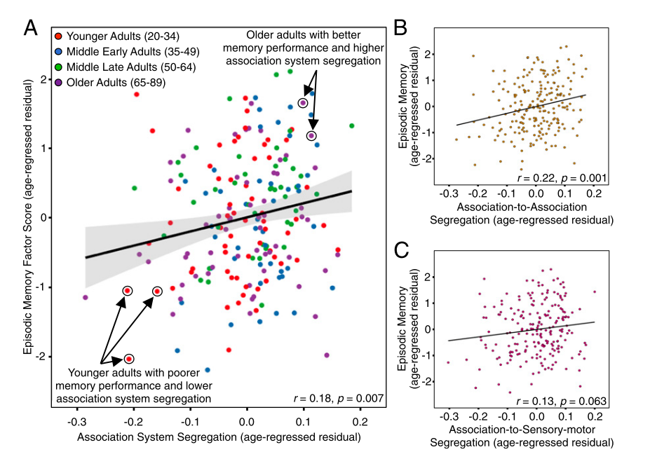
A) Greater association system segregation is associated with superior long-term episodic memory, independent of age
B) Relationship between episodic memory and segregation of association systems from other association systems and C) segregation of association systems from sensory-motor systems.

Slide 11
Discussion
Increasing age is associated with decreasing segregation of functional brain systems
Compared with sensory-motor systems, association systems exhibit greater decreases in segregation from ∼50 years of age onward and non linear trend > may reflect different trajectories in the patterns of decreasing functional specialization
Individuals with less segregated association systems exhibited the poorest memory ability.
Distinct systems exhibit greater interaction > not appear that the increasing interaction between areas in distinct systems confers a benefit to the individual; rather increased “blurring” across systems and decreased communication within systems
Cognitive decline is the consequence of reduced functional specialization of these systems
Global efficiency (GE) and age reveal that increasing age is accompanied by increasing GE. This is trivial when one recognizes that strengthening of connections between systems quickly decreases average path length
Segregation well suited toward characterizing and understanding the complex organization of brain networks across various cohorts and species and how this organization develops, differs, and evolves in relation to behavior

Slide 12
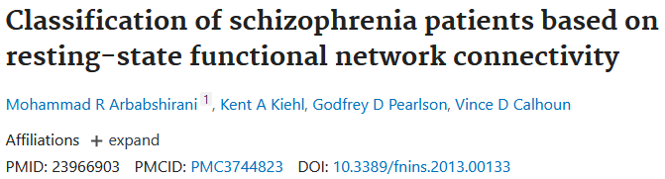

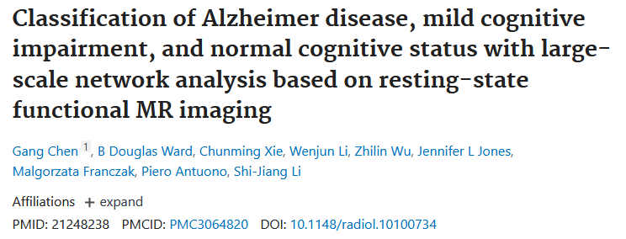

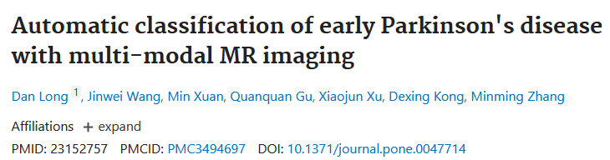

Slide 13

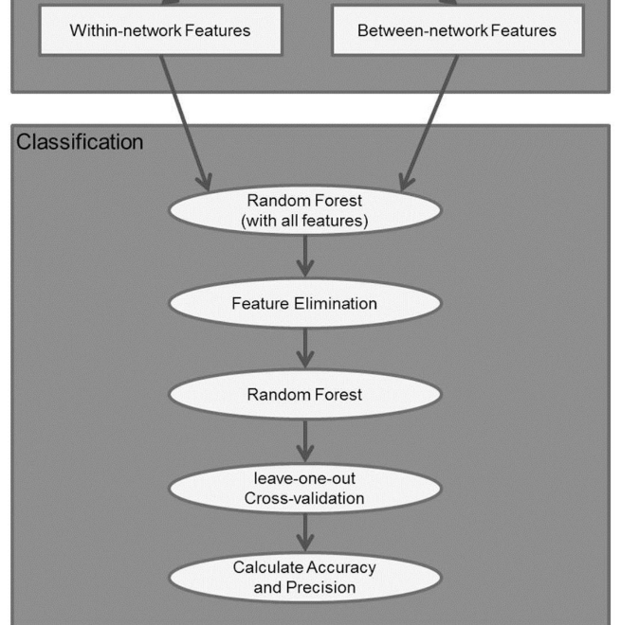
Machine-learning algorithms provide alternative tools to look into multivariate patterns in the data, and help us move from group- level analysis to case-by-case individual-level analysis
Sought to identify connectivity features in a multivariate fashion that are predictive of alcohol dependence
a) Whether rs-FC features are able to distinguish between AUD and controls; b) Which brain-based features are able to diagnose and are potentially predictive of alcohol dependence? and c) Can we quantify how well they identify AUD and what are the best neuronal predictors of AUD?
46 controls and 46 AUDs. Both within-network connectivity for each network and between-network connectivity for each pair of networks were used as features. Random forest was applied for pattern classification.
The results showed that within-networks features were able to identify AUD and control with 87.0% accuracy and 90.5% precision. Networks that were most informative: Executive Control Networks (ECN), and Reward Network (RN). The between-network features achieved 67.4% accuracy and 70.0% precision. The between-network connectivity between RN-Default Mode Network (DMN) and RN-ECN contribute the most to the prediction.

Slide 14
Within network connecitivity
Global/local efficiency
Segregation global
Between network connecitivity
Segregation association networks
Path length
Structural network features
Functional network features
Modularity
Segregation sensory networks
Structural connectivity
Random Forest (all features)
Feature Elimination
Cross validation
Accuracy and Precision

Slide 15
Random forest, an ensemble machine-learning algorithm, builds a group of weak learners of decision trees to form a “strong learner”, thereby improving the generalization ability of the classifier
Two levels of randomness: first each tree uses a bootstrapped version of the training data (bagging). Specifically, about 66% of the training data was used for each tree with replacement; the remaining training data was used to estimate error and variable importance.
A second level of randomness is added at each node when growing a decision tree by randomly selecting a subset of variables to split. At each internal node, a best feature among a random subset of features is selected so as to maximize the reduction of label impurity, typically measured with the class entropy. The process is recursively repeated until the tree has either reached a predefined depth or the number of samples in a node falls below a threshold, or all the samples belong to the same class.
mportant advantages over other techniques in terms of its ability to handle highly non-linear biological data, robustness to noise, tuning simplicity (compared to other ensemble learning algorithms), and opportunity for efficient parallel processing [18].
Classification of a new instance can be made by taking the majority vote from all the decision trees. It’s often helpful to calculate relative importance or contribution of each feature in predicting the label.

Slide 16
1) mean decrease impurity, i.e. average of the accumulated decrease in node impurity over all trees for each feature
mean decrease accuracy, i.e. the decrease in accuracy on out-of-bag (OOB) samples by randomly permuting values for each feature.
python package scikit random forest [19]
Feature elimination
total number of variables is large, but the fraction of relevant variables is small, then random forests are likely to perform poorly due to the small chances that the relevant variables being selected.
In the current study, random forest was first performed on all features, and the ranking of average feature importance was used for feature elimination
performance of the classifier was then evaluated based on accuracy, and precision. The prediction data included true positive (TP), false negative (FN), true negative (TN), and false positive (FP) classifications.

Slide 17
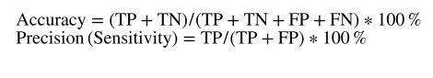
Classification performance
The performance of the classifier was then evaluated based on accuracy, and precision. The prediction data included true positive (TP), false negative (FN), true negative (TN), and false positive (FP) classifications
To explore an optimal set of feature variables, datasets were entered individually, and the prediction accuracy was computed by using leave-one-out cross-validation (LOOCV). I

Slide 18
First, we showed that the rs-FC features are able to automatically discriminate AUD from controls. Second, we quantitatively compared the performance of within-network and between-network features that contribute most to the classifier and identified the features best detecting alcohol dependence. With the help of the feature elimination method, our results showed that the within-network features distinguish AUD from controls with 87% accuracy and 90.5% precision, higher than the performance using between-network features (67.4% accuracy and 70.0% precision).

Slide 19
Klinik, Institut, Geschäftsbereich
Martinistraße 52 | D-20246 Hamburg
Ansprechpartner
Telefon +49 (0) 15202781606 m.schulz1@uke.de | www.uke.de

